Slide 1
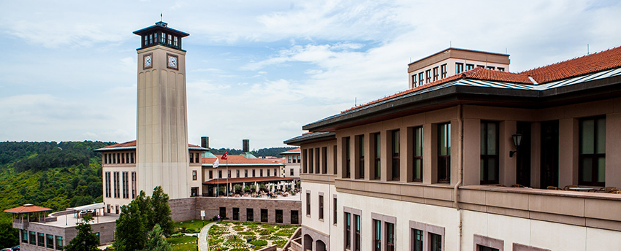
College of Social Sciences and Humanities (CSSH)
Koç University
Aylin Küntay
Inge Uytterhoeven

Slide 2
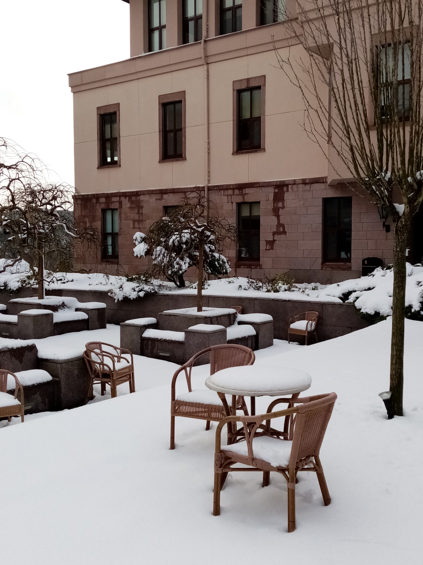
College of Social Sciences and Humanities (CSSH)
Degree-granting Departments
Archaeology and History of Art (ARHA)
Comparative Literature (COMPLIT)
History (HIST)
Media and Visual Arts (MAVA)
Philosophy (PHIL)
Psychology (PSYC)
Sociology (SOCI)
Supporting Programs
Academic Writing (ACWR)
Turkish Communication Skills (TURK)
Languages (LANG)
Koç University Writing Center (KUWR)

Slide 3
Academic Environment
Interdisciplinary research and teaching
Double Major
Minor Programs
Track and Certificate Programs
International mobility and research
Participation in research projects
Close collaboration, learning and research with MA and doctoral students

Slide 4
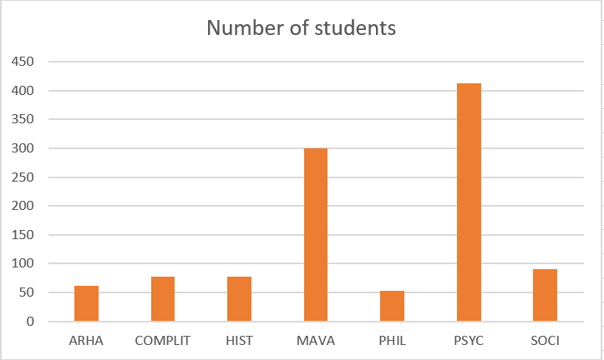
Undergraduate Students

Slide 5
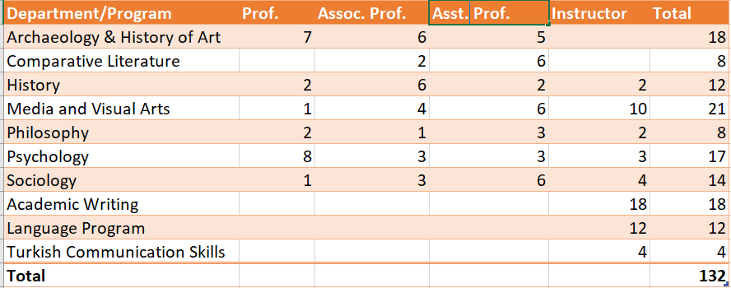
Research Faculty & Instructors

Slide 6
Graduate Students
Graduates
702
223 Ph.D.
556 MA
59 LL.M.
Students
506
12 MA (Thesis)
7 MA (Non-Thesis)
9 Ph.D.
Programs
28
198 MA
85 LL.M.
87 Ph.D.

Slide 7
Example Projects: ERC
Industrialization and Urban Growth from the mid-nineteenth century Ottoman Empire to Contemporary Turkey in a Comparative Perspective, 1850-2000
The New Politics of Welfare: Towards an ‘Emerging Markets’ Welfare Regime

Slide 8
Example Projects: FP7, H2020
Cultural Pathways to Economic Self-Sufficiency and Entrepreneurship
Second Language Tutoring Using Social Robots

Slide 9
Other Relevant Projects
Influence of Socioeconomic Status on the Cognitive Origins of Cultural Learning
Mixed Media Technologies – Educational and Health Applications
Institutional Habitus and Educational Achievement in a Comparative Perspective between Germany and Turkey
Anatolian Neolithic Studies of Unique Technologies for Food Preparation

Slide 10
CSSH & UNIC
Exchange Agreements
Pre UNIC
Ruhr University Bochum: Psychology, Sociology, MA Psychology
Erasmus University Rotterdam: Psychology, Media and Visual Arts, Sociology
During UNIC
Ruhr University Bochum​ | Media and Visual Arts​ | Valid for 2021-2022
University of Liege​ | Media and Visual Arts​ | Under negotiation​
University of Zagreb​ | Comparative Literature​ | Under negotiation​
University of Liege​ | Comparative Literature​ | Under negotiation​
University of Zagreb​ | Archaeology & History of Art​ | New proposal by partner

Slide 11
CSSH & UNIC
Virtual Mobility Courses
MAVA 102 | Introduction to Media and Communication
SOSC 105 | Migration and Globalization
SOCI 435 | Advanced Topics in International Migration
ARHA 320 | Rome, Roman Cities and Countryside
ARHA 455 | Arch. Hist of Hospital, Healthcare Spaces
ARHA 121 | Intro to History of Art and Visual Culture
HIST 355 | Selected Topics in History: Screening Soviet Socialism (and Beyond): Films of the Soviet Union and Russia
HIST 319 | The Mediterranean in History, 16th-20th c.
MAVA 406 | Media, Culture and Society
Virtual Exchange Course
KU-EUR-RUB-UCC codesigned and cotaught course on “Dignified Spaces in Plural Europe” for Spring 2022
Multilingualism Policy Guideline
Contributed to UNIC level discussions and prepared the KU draft

Slide 12
CSSH & UNIC
Contribution to Joint-8 Degrees
Redesigning the Post-industrial City (RePIC) (Joint-8): KU is hosting a track on diversity and design with EUR. MAVA Department is involved.
Multidisciplinary Perspectives on Superdiversity in Intercultural Working-, Teaching-, and Learning- Settings (Joint-8): a semester on organizations and/or sociological perspectives possible by KU. A faculty member from the SOC department is involved in the discussions.
PhD Cooperation (Graduate School of Social Science and Humanities: PhD in Sociology & Political Science and International Relations)
BIP Aeneas Route
University of Sienna, in collaboration with Koç University, Aristotle University of Thessaloniki, Trinity College Dublin, University of Tirana, and the University of Carthage (Spring and Fall 2022). ARHA Department is involved.

Slide 13
Interests in Co-Teaching/Co-Designing

Slide 14
Interests in Research Cooperation

Slide 15
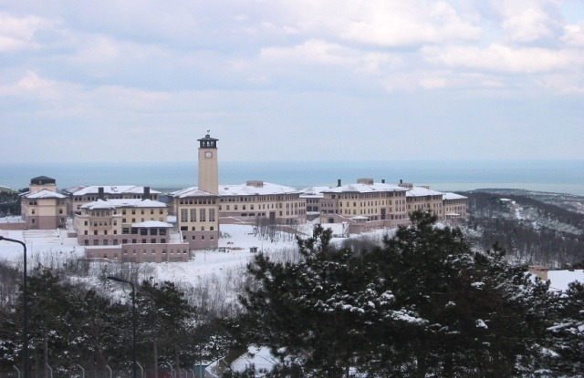
Thank You!
cssh.ku.edu.tr
For Additional Information
Koç University Communications Office Phone: +90 212 338 1501 information@ku.edu.tr http://www.ku.edu.tr

Slide 16
